Slide 1


Security Evaluation
of
'Gate System’ by team2
ShinPark Team

Slide 2
0. Introduction
Security Evaluation
LGE security specialist Team 1 evaluated ‘Gate system’ by team2
Evaluation is done from the security point of view.
The evaluation items are as follows:
Design Analysis
Architecture Review
Secure coding
Code Review
Static Analysis
Open-Source Vulnerability Scan
Testing
Dynamic Analysis
Fuzz test
Function Test
Penetration test

Slide 3
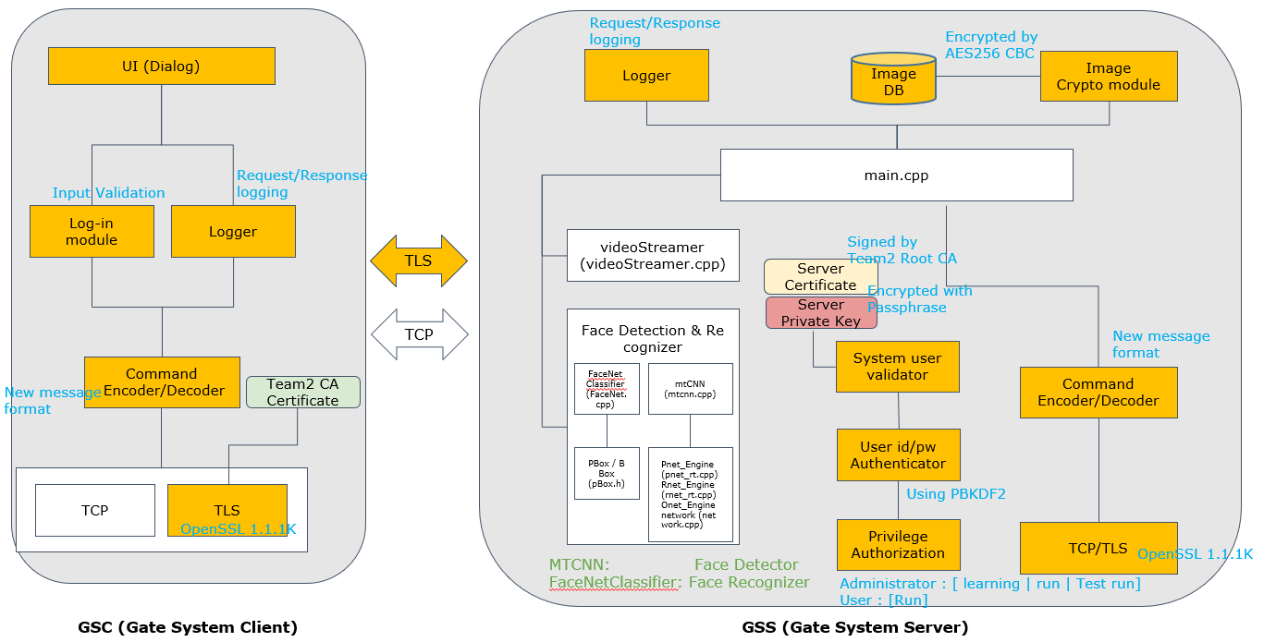
1. Design Analysis – Architecture Review
Security Evaluation
Check architecture whether STRIDE is considered
②
③
④
③
④
①
①
②
④
⑥
① Spoofing - Authenticate via TLS certificates between GSC and GSS
② Tampering - Encrypt User information and Image DB
③ Repudiation - Logging operation for non-repudiation
④ Information disclosure - Encrypt Sensitive data and communicate via TLS
⑤ Denial of Service – Could not find the design (ex. Firewall, IDPS, Service manager, log rotation, etc.)
⑥ Elevation of Privilege - Permission control by ID

Slide 4
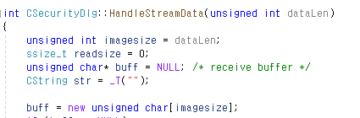
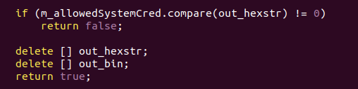
2. Secure Coding – Code Review
Security Evaluation
Eye inspection for implementation vulnerabilities in source code
Ex #1. Insufficient size check : A crash occurs when dataLen is 0
Ex #2. Memory leak : Missing memory release when if status is false.
It doesn't matter as the program ends immediately, but it can cause problems afterwards.

Slide 5
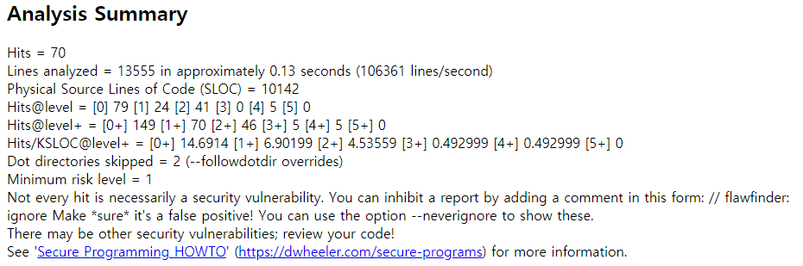
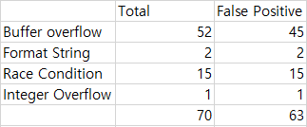
2. Secure Coding – Static Analysis (flaw finder)
Security Evaluation
Static Analysis with ‘flaw finder’.
Can check the CWE-based secure coding guide.
Out of 70 issues, 7 issues are meaningful flaws, 63 issues are considered as ‘False Positive’.
Ex #1. Does not check for buffer overflows with ‘sprintf’.

Slide 6
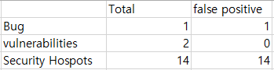
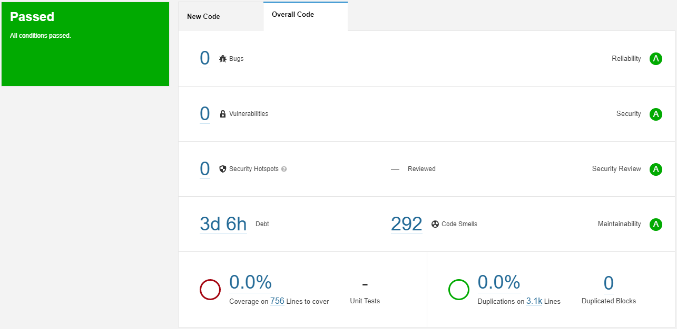
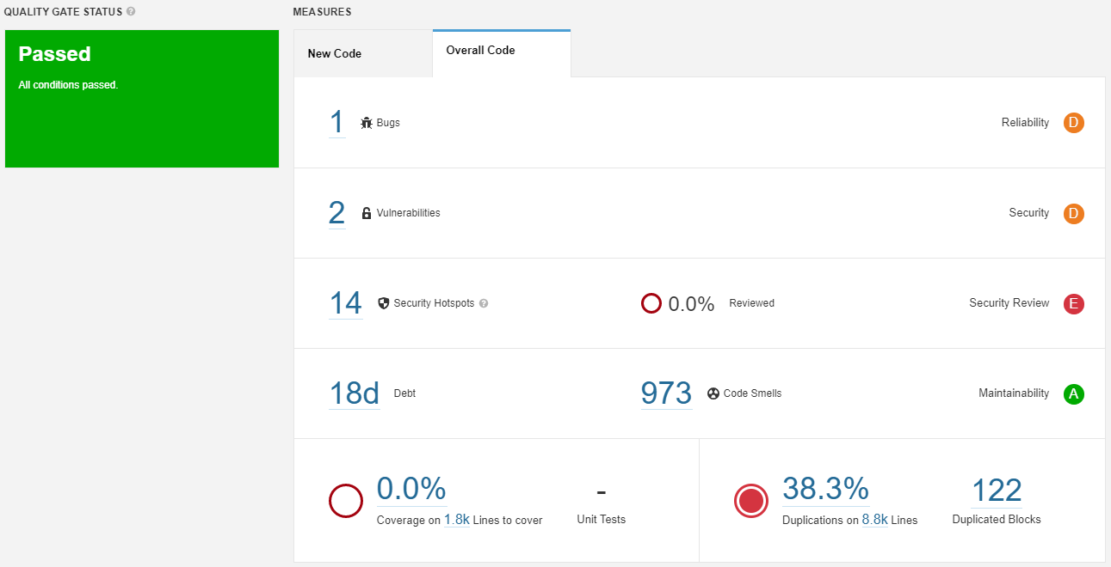
2. Secure Coding – Static Analysis (SonarQube)
Security Evaluation
Static Analysis with ‘SonarQube’.
No issue detected by Client.
1 Bugs, 2 Vulnerabilities, 14 Security Hotspots detected by Server.
Can check various standards-based vulnerabilities(CERT, OWASP, Misra C++, etc).
Can obtain compliance solutions.
<Client>
<Server>

Slide 7
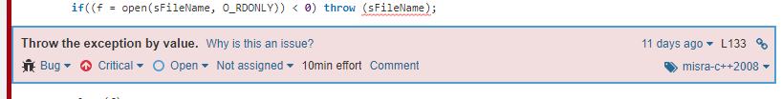
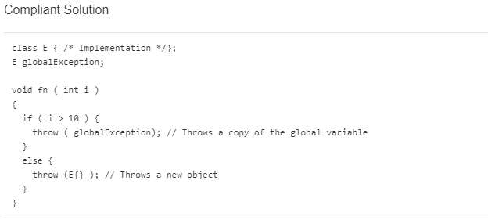
2. Secure Coding – Static Analysis (SonarQube)
Security Evaluation
Ex #1. Bug

Slide 8
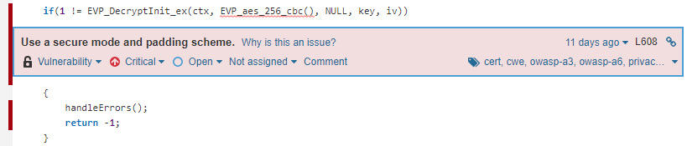
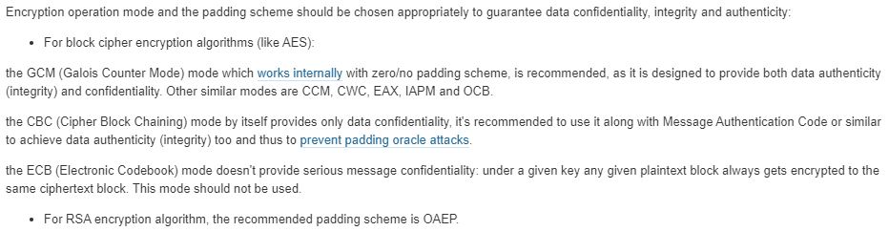
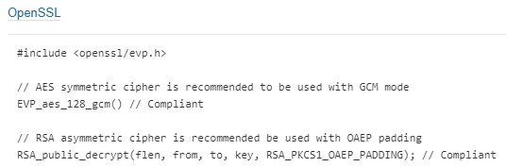
2. Secure Coding – Static Analysis (SonarQube)
Security Evaluation
Ex #2. Vulnerability

Slide 9
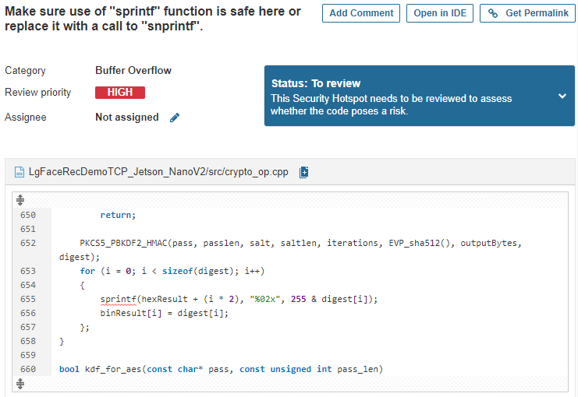
2. Secure Coding – Static Analysis (SonarQube)
Security Evaluation
Ex #3. Security Hotspots

Slide 10

2. Secure Coding – OSSVS
Security Evaluation
‘Gate System’ use some of open source as follows:
nvidia cuda (common)
tensorrt (common)
OpenSSL (specified)
Opencv (common)
Open Source Security Vulnerability Scan performed with used openSSL version. (except for common open source)
Ex #1. OpenSSL
https://www.openssl.org/news/vulnerabilities-1.1.1.html
Gate system uses OepnSSL 1.1.1k version (latest version)
Major changes between OpenSSL 1.1.1j and OpenSSL 1.1.1k
Fixed a problem with verifying a certificate chain when using the X509_V_FLAG_X509_STRICT flag ([CVE-2021-3450])
Fixed an issue where an OpenSSL TLS server may crash if sent a maliciously crafted renegotiation ClientHello message from a client ([CVE-2021-3449])

Slide 11
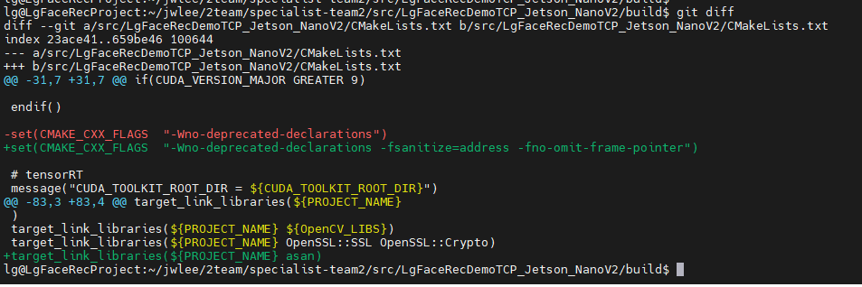
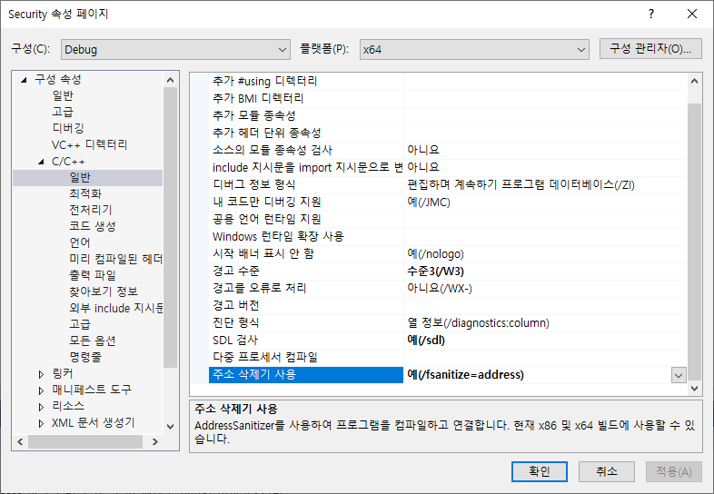
3. Test – Dynamic Analysis
Security Evaluation
Dynamic Analysis with ‘ASan’.
‘Address Sanitizer’(ASan) can detect memory bugs
No significant memory-caused crashes during nomal testing on server/client

Slide 12
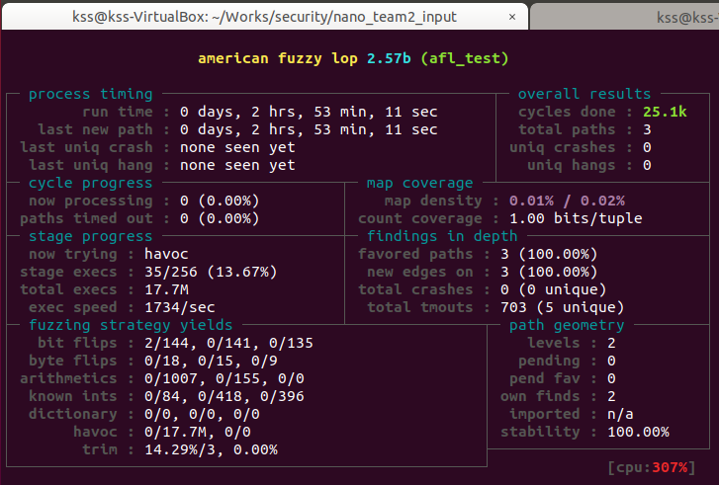
3. Test – Fuzz Test (AFL)
Security Evaluation
Fuzz testing with ‘AFL’.
Input validation is critical for security, so we performed AFL.
The Server receives the port number and secure mode of operation from user.
No Crashes, No hangs. But…
portNum = atoi(argv[1]);
if(!strcmp(argv[2], "0")) bSecureMode = false;
SEI CERT C Coding Standard
Use strtol() instead of atoi()
ERR34-C. Detect errors when converting a string to a number
Use one of the C Standard Library strto*() functions to parse an integer or floating-point number from a string. These functions provide more robust error handling than alternative solutions.

Slide 13
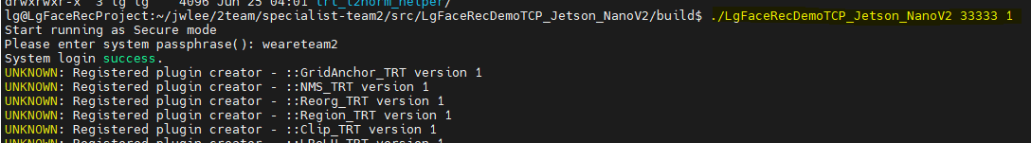
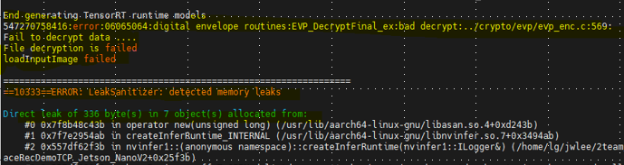
3. Test – Fuzz Test (Manual Fuzz)
Security Evaluation
Fuzz testing with ‘Tampering’.
The tampered data caused not only errors but also memory leaks.
Error handling have to consider Memory leaks.
<just Modify Image file name>
<Run Server>
<Result>
1. service dead due to decryption fail
2. service doesn`t free memory when exception occurred

Slide 14
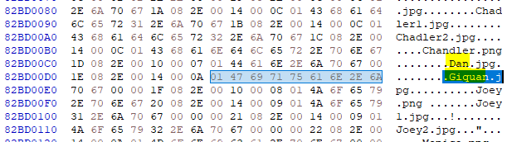
3. Test – Forensic Test
Security Evaluation
Full Memory Dump in Server
Full physical memory dump and analysis
Found some credential data in memory (passphrase, user name)
Memory dump using LiME(https://github.com/504ensicsLabs/LiME)
sudo insmod ./4.9.201-tegra/updates/dkms/lime.ko "path=/home/lg/jwlee/mem.lime format=lime“
lg@LgFaceRecProject:~/jwlee$ cat /proc/meminfo | grep MemTotal
MemTotal: 4059272 kB (<- 4GB memory)
lg@LgFaceRecProject:~/jwlee$ ll mem.lime
-r--r--r-- 1 root root 4259315808 Jun 29 05:10 mem.lime (<- full dumped)
Analysis dumped file using HxD(HxD - Freeware Hex Editor and Disk Editor | mh-nexus)
passphrase -> ‘weareteam2’
name as plain text -> ‘Dan’, ‘Giguan’, etc

Slide 15
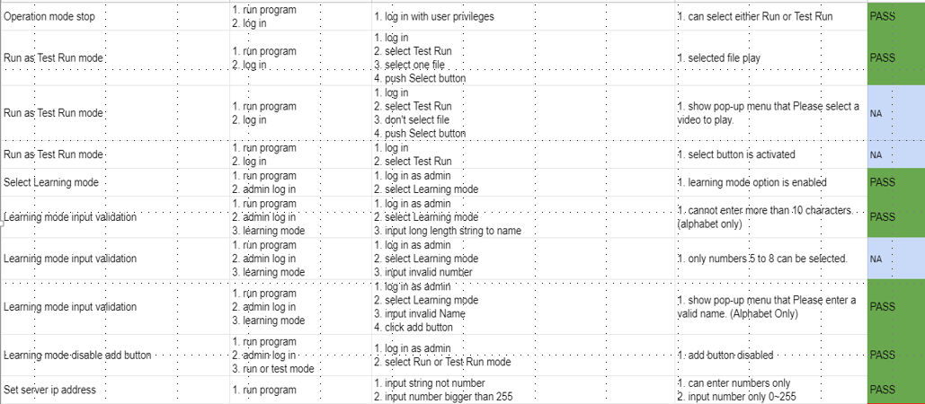
3. Test – Test Case
Security Evaluation
Testing with ‘Test Case’.
Original test case by developers was passed all.
Some of Test Case are added to meet the security requirements as follows:
Requirements
Learning Mode - User images can be added to the image database. In this mode the interface should query for the name of the person in front of the camera and the number of samples to be collected.
Proper fault/error detection, recovery, and reporting.
No | Test case | Result | Description
24 | In Learning Mode the interface should query for the name of the person in front of the camera and the number of samples to be collected. | Fail | The interface does not query the number of samples to be collected. → Failed to meet system requirements
25 | If the server is forcibly terminated, it should restart again. | Fail | If the server is forcibly terminated with 'sudo pkill' command, it was not restarted. → Insufficient system resiliency / robustness

Slide 16
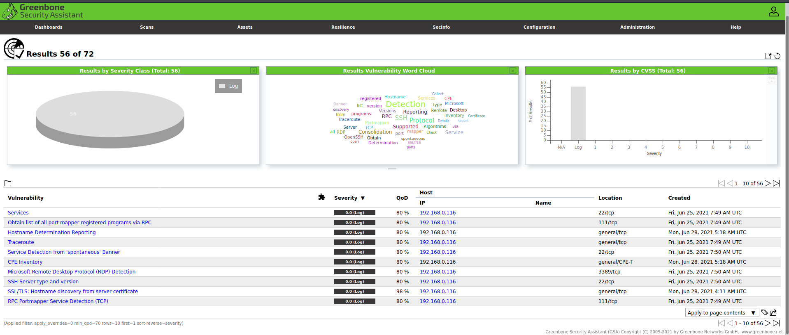
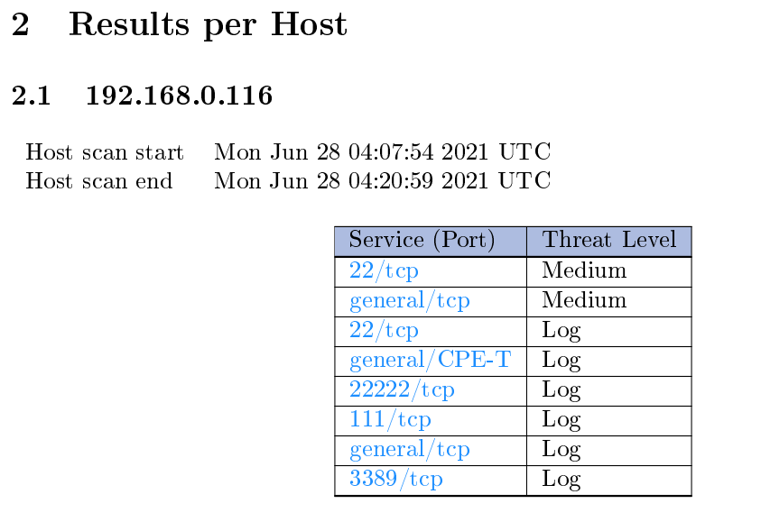

3. Test – OpenVAS
Security Evaluation
Open Vulnerability Assessment Scan performed with ‘OpenVAS ’.
OpenVAS can check network vulnerability.
Detected 2 medium level vulnerabilities
Service(port) | Subject | Vulnerability insight | CVE
SSH | OpenSSH <= 8.3p1 Command Injection Vulnerability | scp of OpenSSH allows command injection in spc.c via backtick characters in the destination argument. | CVE-2020-15778
General TCP | TCP Sequence Number Approximation Reset Denial of Service Vulnerability | The flaw is triggered when spoofed TCP Reset packets are received by the targeted TCP stack and will result in loss of availability for the attacked TCP services. | CVE-2004-0230

Slide 17
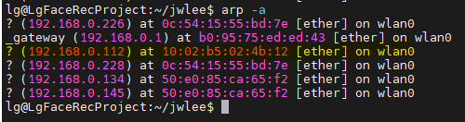
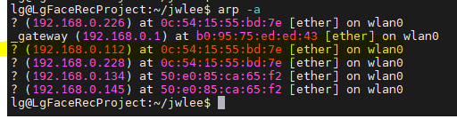
3. Test – Penetration Test
Security Evaluation
Penetration testing with ‘Dos Attack’.
Attempted ARP(Address Resolution Protocol) spoofing and Send TCP Reset packet to Client
➔ Client can`t receive Server`s data(face img,etc…) and closed TCP connection by attacker
To avoid MITM (Man In The Middle Attack), firewall/IDS have to be considered.(detect spoofing)
Service(port) | Subject | Vulnerability insight | CVE
General TCP | TCP Sequence Number Approximation Reset Denial of Service Vulnerability | The flaw is triggered when spoofed TCP Reset packets are received by the targeted TCP stack and will result in loss of availability for the attacked TCP services. | CVE-2004-0230
192.168.0.116
(Server)
192.168.0.112
(Client)
8c:c6:81:da:7c:e4
10:02:b5:02:4b:12
Normal ARP cache of Server
1. Send ARP reply packet
with fake MAC address to the server
2. Send TCP Reset packet to the client
192.168.0.226
(Attacker)
08:00:27:a9:b7:9a(NAT)
0c:54:15:55:bd:7e(org)
Spoofed ARP cache of Server

Slide 18
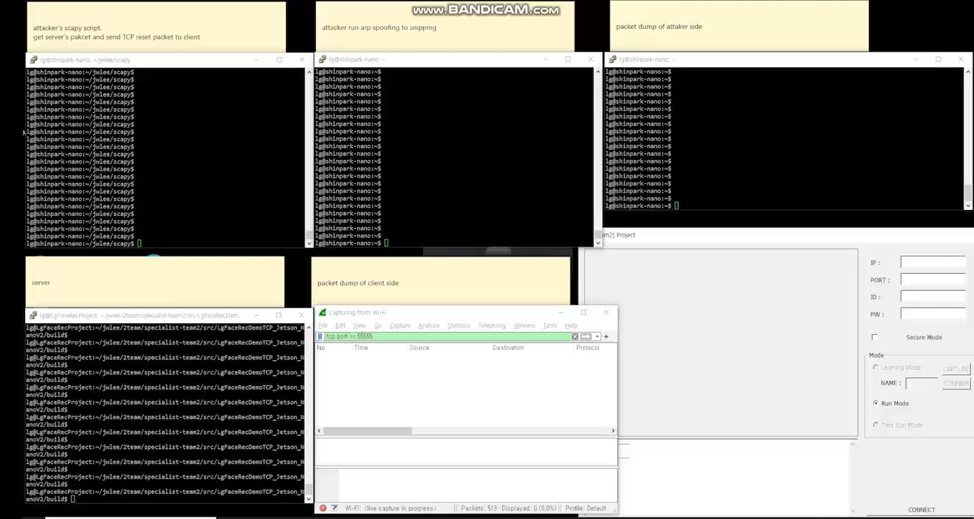
3. Test – Demo
Security Evaluation

Slide 19
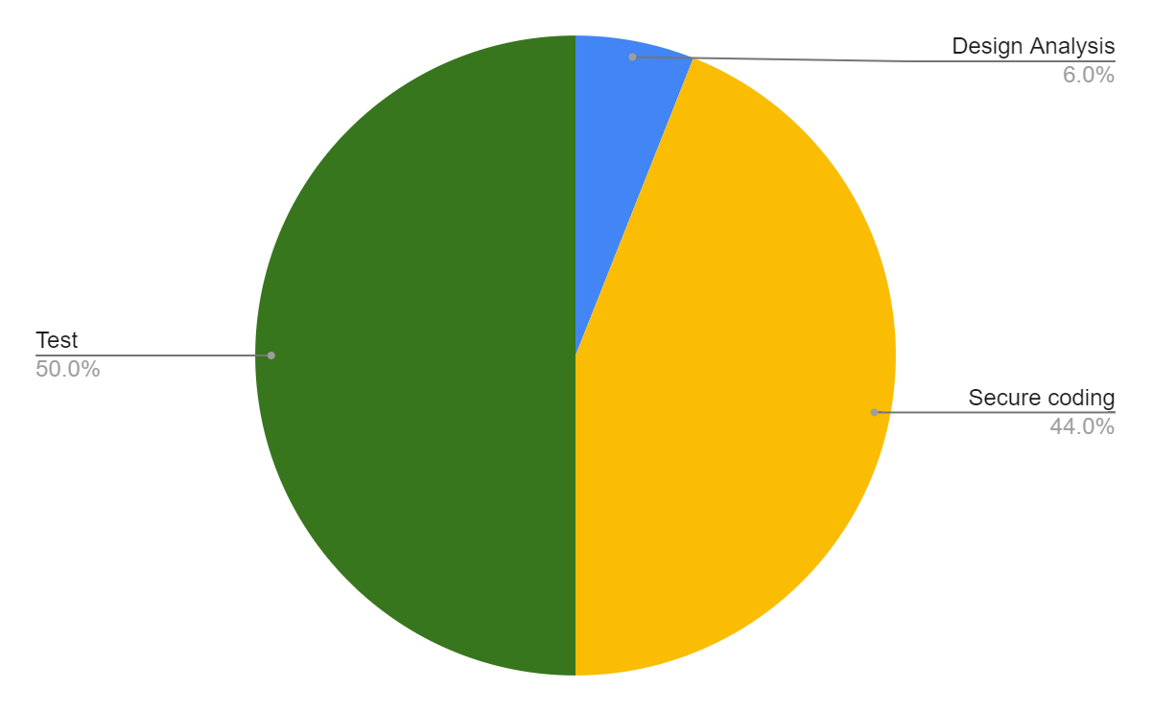
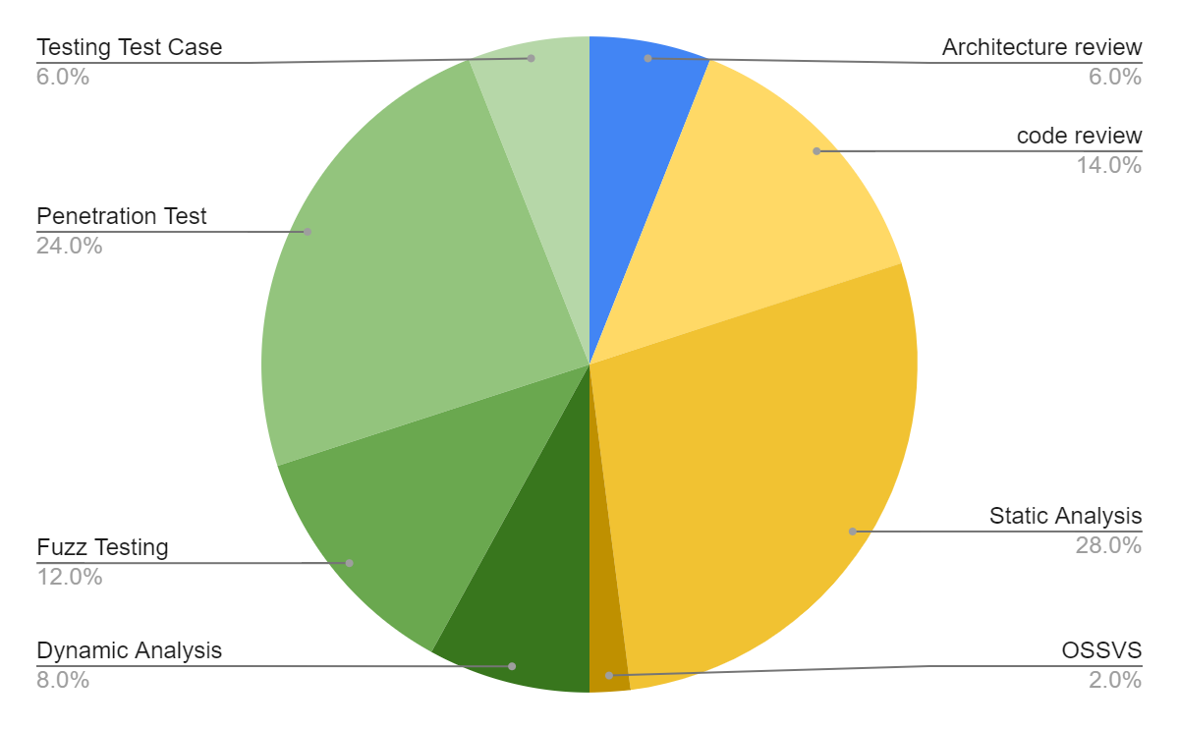
4. Evaluation summary
Security Evaluation
Time distribution
Total : Approximately 90 hours
Test : 50%, Secure code review : 44%, Design Analysis : 6%
Identified Outcomes
Lesson | Activities | Vulnerabilities/Issues
Design Analysis | Architecture review | 0
Secure coding | Eye inspection | 3
 | Flow finder | 70 (but 63 is false positive)
 | Sonar qube | 17 (but 15 is false positive)
 | OSSVS | 0
 | OpenVAS | 2(but 1 is out of scope)
Test | Dynamic Analysis (ASAN) | 0
 | Fuzz Testing (AFL, Manual) | 1
 | Penetration Test (DoS, Memory) | 2
 | Testing Test Case | 2

Slide 20
5. Lessons and Learned
Security Evaluation
Lesson | Activities | Learned
Design Analysis | Architecture review | Architecture should be designed considering all STRIDE.
Secure coding | code review | Eye inspection code review are meaningful but have limited issue detection.
 | Static Analysis | Static analysis tool should consider several coding rule standards Analysis process should be systematically managed.
 | OSSVS | The way to avoid open-source vulnerabilities is to always have the latest version.
Test | Dynamic Analysis | Dynamic analysis can detect subtle flaws or vulnerabilities that cannot be detected by static analysis. Dynamic and static analysis are complementary because a single approach cannot find all errors.
 | Fuzz Testing | Error handling have to consider Memory leaks.
 | Penetration Test | Trying to attack a system similarly to a malicious hacker can help you understand the importance of security.
 | Testing Test Case | A properly written requirement can create an accurate test case. Vulnerabilities that could not be found through static analysis may be discovered through testing.

Slide 21
Appendix

Slide 22
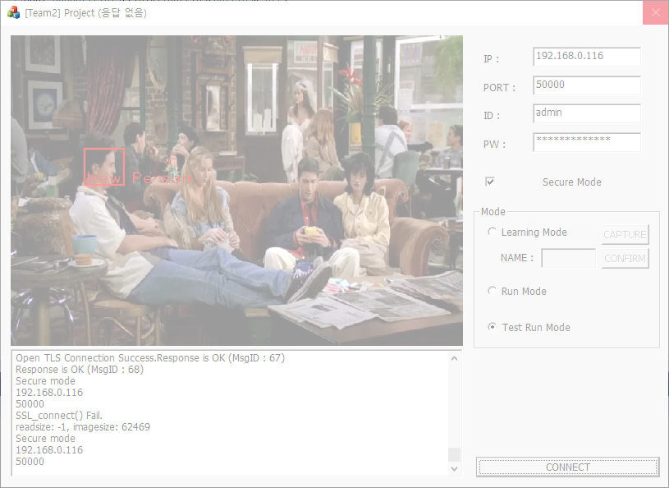
Appendix – Functional Test
Security Evaluation
Application operation test for functional verification.
Although it was excluded from the security evaluation item, the verification of the basic function was also performed.
These errors are occurred in Secure Mode only.
Case #1. No response in Test Run Mode
Select Secure Mode
Select Test Run Mode
Repeat connect and disconnect
Client program has stopped working

Slide 23
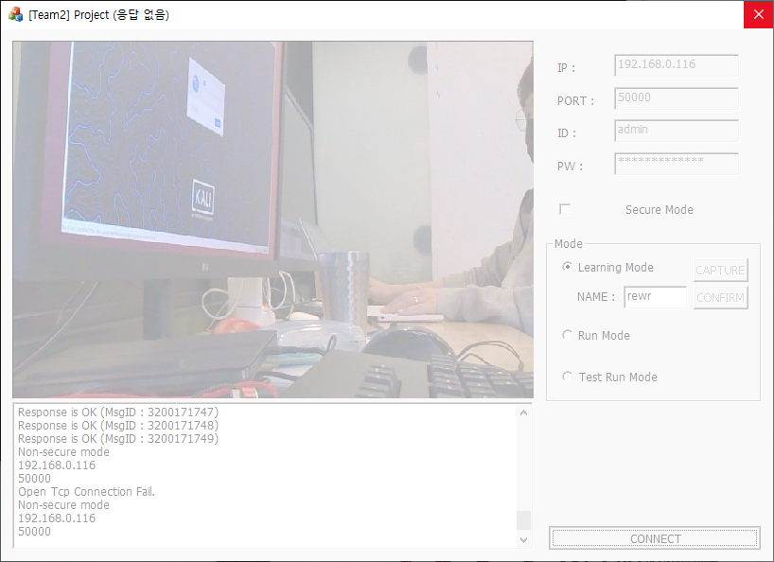
Appendix – Functional Test
Security Evaluation
Case #2. No response in Learning Mode
Select Secure Mode
Select Learning Mode
Press CONFIRM button repeatedly.
Select DISCONNECT button
Client program has stopped working

Slide 24
Thank you!

